Slide 1
LIBS 7001 Wk. 8, MECH - Persuasion; Ethos
Administrative
  research paper: topic approvals & progress
  midterms - returned at end of class
  Analysis Essay – rewrite option
This week begins the last major thematic unit in the course: Persuasion; ethos
Next week: logos
Nov. 11: no class - Remembrance Day

Slide 2
Agenda for Today
From last week – citation help
lecture: appeals in argument; ethos
seminars / discussion of this week’s readings:
  Neal: “Necessary Art of Persuasion”
  Mike B: “Should Human Cloning Be Permitted?”
  Fazmin: “Yes, Human Cloning Should Be Permitted”
if time allows:
  credibility exercise, to help w/Res. Paper

Slide 3
Online citation-format sites
Better: from the Library of the Univ. of North Carolina at Chapel Hill:
  http://www.lib.unc.edu/house/citationbuilder
Good: Son of Citation Machine
  http://citationmachine.net

Slide 4
Next Week
Persuasion / Logos & Fallacies
Readings / Seminar / Discussion
  Read all the assigned essays before class, as well as questions, author bios
  Discussion of
    selections from Machiavelli’s The Prince – seminars by Mat and Jacky
    Tareq Ismael, “Beating the Drum….” – seminar by Kevin
Keep on track in working on your research paper

Slide 5
Expository Writing
purpose(s):
  to illustrate
  to entertain
  to inform or tell
  to explain or analyze
major concern: to be clear
Persuasive Writing
purpose
  to convince an audience of the validity of an idea or action
major concern: to present ideas in the most convincing way
All persuasive texts use expository techniques

Slide 6
Persuasion: Basic Terms
Argument:
“a collected series of statements to establish a definite proposition…an intellectual process…not contradiction”
in writing, a paper, grounded on logical, structured evidence, that attempts to convince the reader to accept an opinion, take some action, or do both.
Motivation: “(1) the psychological feature that arouses [someone] to action toward a desired goal” (WordNet)

Slide 7
“Argument” & “Persuasion”
(SSW, Ch. 14)
Arguments
  most have many sides; must have at least two sides; some topics aren’t arguable
  can seek to
    establish consensus / common ground
    persuade those neutral or undecided to adopt a new idea or course of action
  are grounded in logical, structured evidence & appeals.
Persuasion
  has a broader meaning: swaying reader’s attitudes by appeal to values and emotions, as well as logic.

Slide 8
Basic Terms, cont.
Appeals: persuasive techniques designed to focus on specific needs and wants.
Three main appeal types, derived from classical rhetoric, as formulated by Aristotle (4th c BCE): :
    ethos: appeal to reputation & credibility
    logos: appeal to reason
    pathos: appeal to emotion
Examples of main appeals (next slide)

Slide 9
Examples: “Be persuaded because…
Ethical (ethos)
  . . . I and my arguments are trustworthy & respectable.”
  . . . people you admire do it.”
  . . . it’s the respectable, moral thing to do.”
Logical (logos)
  . . . I give you sound facts, figures, & arguments.”
  . . . it’s the reasonable, logical thing to do.”
Emotional (pathos)
  . . . you’ll feel good if you do.”
  . . . you’ll feel bad if you don’t.”

Slide 10
Challenges of Persuasion
to show you’re honest and well informed on the issue, and therefore deserve a hearing.
to construct a sound argument
to arouse the interest of the audience through a legitimate appeal to their emotions

Slide 11
Importance of Ethos
(Corbett, Classical Rhetoric for the Modern Student, pp. 71-75)
“People are creatures of passion and will as well as intellect” (p. 71), so persuasion involves more than logical proofs alone
Ethical appeal “is exerted when the speech itself impresses the audience that the speaker is a person of high moral character (arete), and benevolence (eunoia)” (p. 72)

Slide 12
“Ethos” in rhetoric is related, but not = “ethics”
from the MSWord dictionary:
Ethos: “the fundamental and distinctive character of a group, social context, or period of time, typically expressed in attitudes, habits, and beliefs.
Ethics: (1) the study of moral standards and how they affect conduct; (2) a system of moral principles governing the appropriate conduct for an individual or group (emphasis added)

Slide 13
An ethical discourse must show that the speaker . . .
(Corbett, Classical Rhetoric for the Modern Student, pp. 71-75)
has adequate grasp of subject being discussed
knows and observes principles of good reasoning
can view the situation in a proper perspective
has good taste and discriminating judgment

Slide 14
An ethical discourse must show that the speaker. . .
(Corbett, Classical Rhetoric for the Modern Student, pp. 71-75)
abhors unscrupulous tactics and specious reasoning
respects commonly acknowledged virtues and integrity
has a sincere interest in the welfare of the audience
is ready to sacrifice self-interest that conflicts with the benefit of others

Slide 15
Ethos in Advertising - 4 examples, form remarkably durable ads
from Harper’s Magazine, Nov. 2007
  Honda
  Chevy
from Vanity Fair Magazine, April 2007
  Balderson’s
  Victorinox
Note: ethical appeal may not be the only appeal used in these ads, but it’s prominent in each ad. How? Where?

Slide 16
Critically Reading for Ethos
Identify elements of ethical appeal that relate to an organization’s
  credibility
  reliability
  social responsibility
  morality
  reputation.
How does the ad use ethical appeal to persuade?

Slide 17
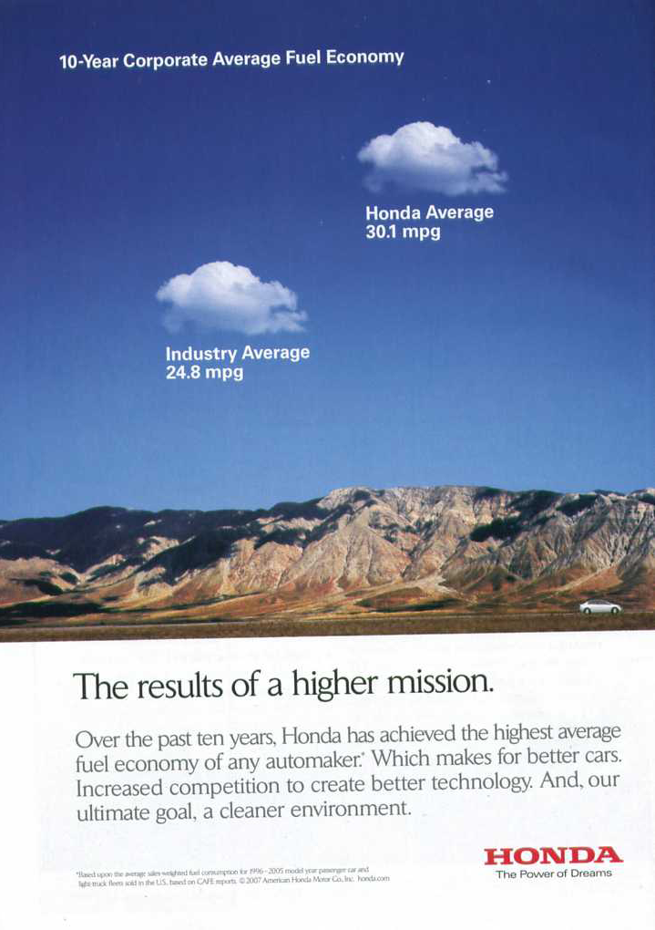


Slide 18
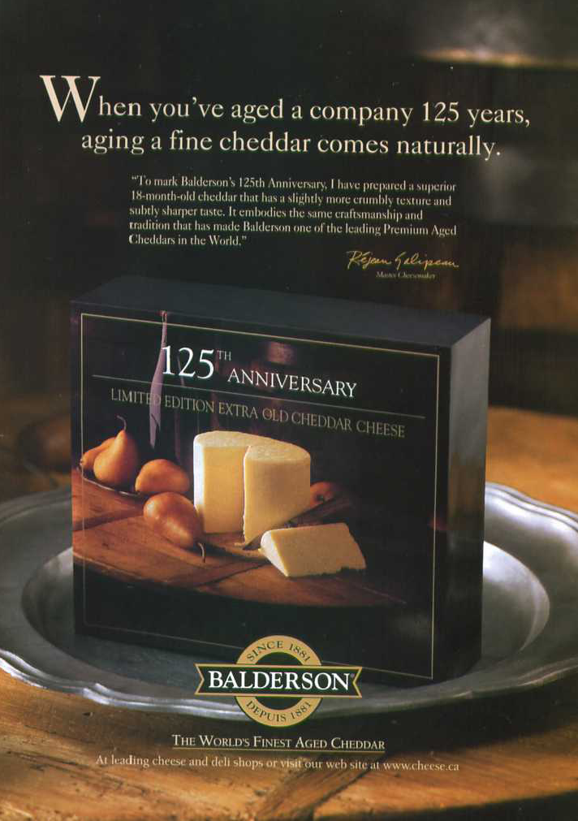

Slide 19


Slide 20
Exercise Your Credibility
On the back of your returned topic-proposal form, answer: “Why should the reader listen to me on this topic?”
In point form, list how, when writing about this topic, your argument and you can
  show your honesty, reliability, competence & interest in the topic, as a professional and/or citizen
  connect with perceived values of your audience (assume the audience is others in this class)
  appeal to the highest, best ideals of your audience
Use these elements of credibility-building in your final paper, especially the opening & closing.

Slide 21
Discussion questions
Conger, “the Necessary Art of Persuasion”
What's the difference between persuasion and "selling"?
What are the essential steps of persuasion as identified by Conger? Give examples of each step, from Conger's discussion, or your own experience
What are the four ways people can fail at persuading?
How does Conger establish credibility in this article? (give two or three techniques he uses)
What aspect of this article surprised or interested you?
Baird and Macdonald on cloning
What are the purpose and audience for each essay?
Give examples of at least THREE ways in which each author constructs her/his credibility as a speaker, and defines an effective relationship with the audience (readers).
Identify the strongest and weakest arguments put forward in the essays.
Were you persuaded by the authors’ arguments? Why or why not?

